Slide 1

Part 1 Volume Rendering Part 2 3D Gaussian Splatting
3D Gaussian Splatting for Real-Time Radiance Field Rendering
Bernhard Kerbl*, Georgios Kopanas*, Thomas Leimkühler, George Drettakis
¹Inria ²Université Côte d'Azur ³MPI Informatik

Slide 2
Overview
What is Volume Rendering?
Volume Scattering (Simplified).
Radiance Field via Volume Rendering.
3D Gaussian Splatting.
Intro & Pipeline
3D Representation via Guassian
Method
Results & Ablations
Existing Works

Slide 3

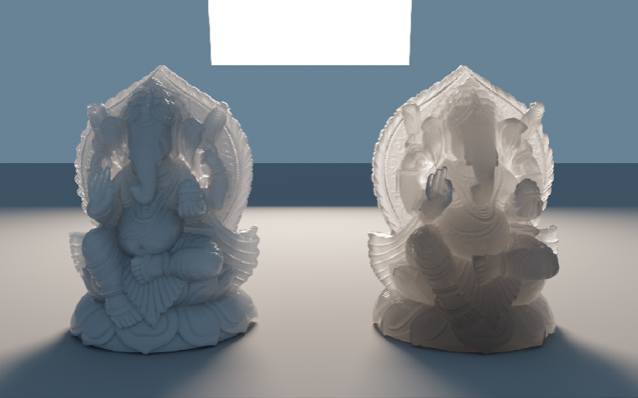
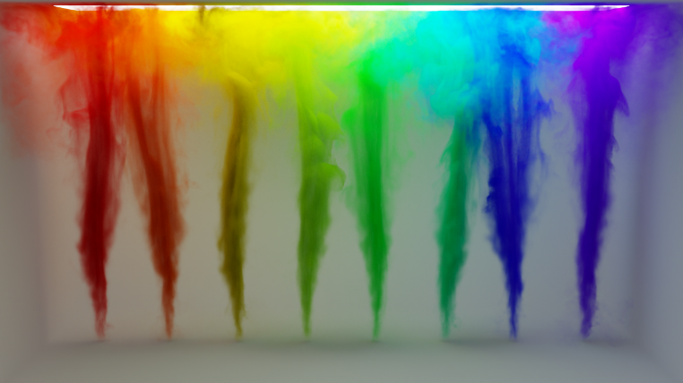
What is Volume Rendering?
Surface Reflection Model
Volume Scattering Model

Slide 4
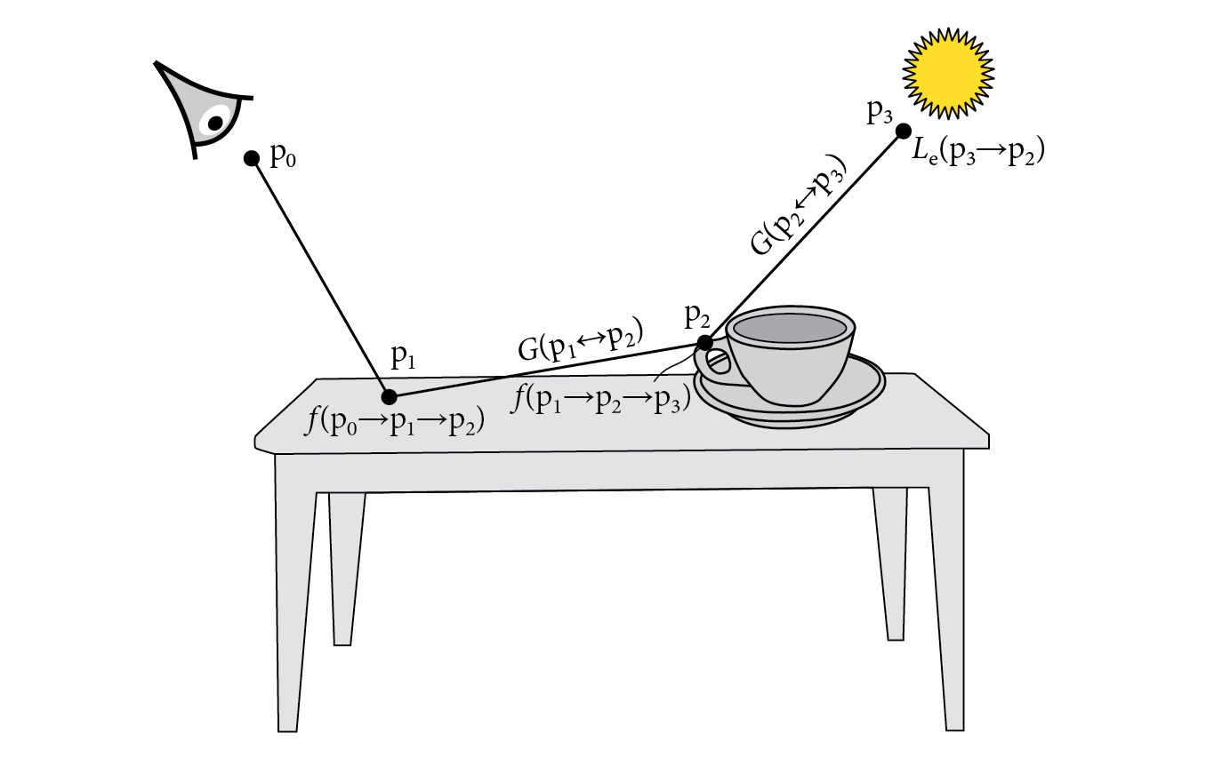
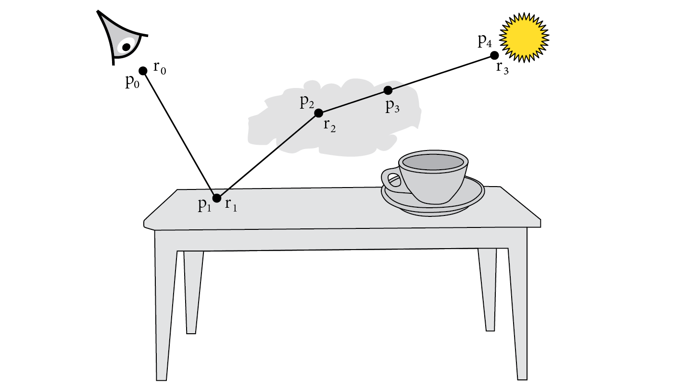
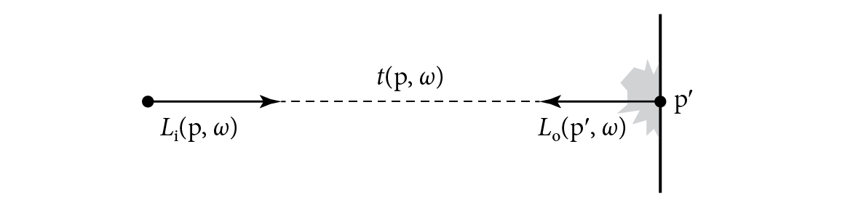

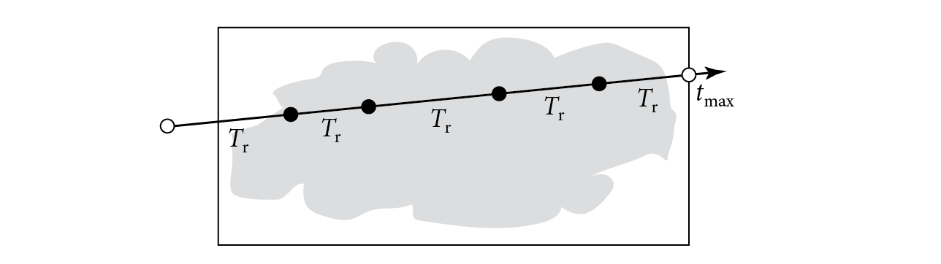
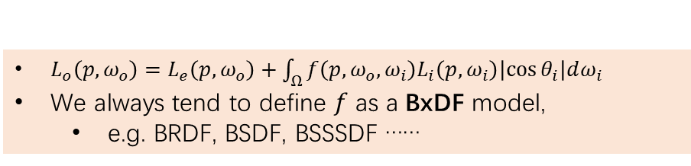
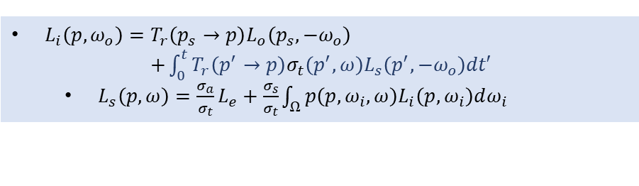
What is Volume Rendering?
Surface Reflection Model
Volume Scattering Model
$L_{o}\left(p,ω_{o}\right)=L_{e}\left(p,ω_{o}\right)+\int_{Ω}{f\left(p,ω_{o},ω_{i}\right)L_{i}\left(p,ω_{i}\right)\left|\cos{θ_{i}}\right|dω_{i}}$
We always tend to define $f$ as a BxDF model,
e.g. BRDF, BSDF, BSSSDF ……
$L_{i}\left(p,ω_{o}\right)=T_{r}\left(p_{s}→p\right)L_{o}\left(p_{s},−ω_{o}\right)$ $+\int_{0}^{t}{T_{r}\left(p^{′}→p\right)σ_{t}\left(p^{′},ω\right)L_{s}\left(p^{′},−ω_{o}\right)dt′}$
$L_{s}\left(p,ω\right)=\frac{σ_{a}}{σ_{t}}L_{e}+\frac{σ_{s}}{σ_{t}}\int_{Ω}{p\left(p,ω_{i},ω\right)L_{i}\left(p,ω_{i}\right)dω_{i}}$
Do Nothing

Slide 5
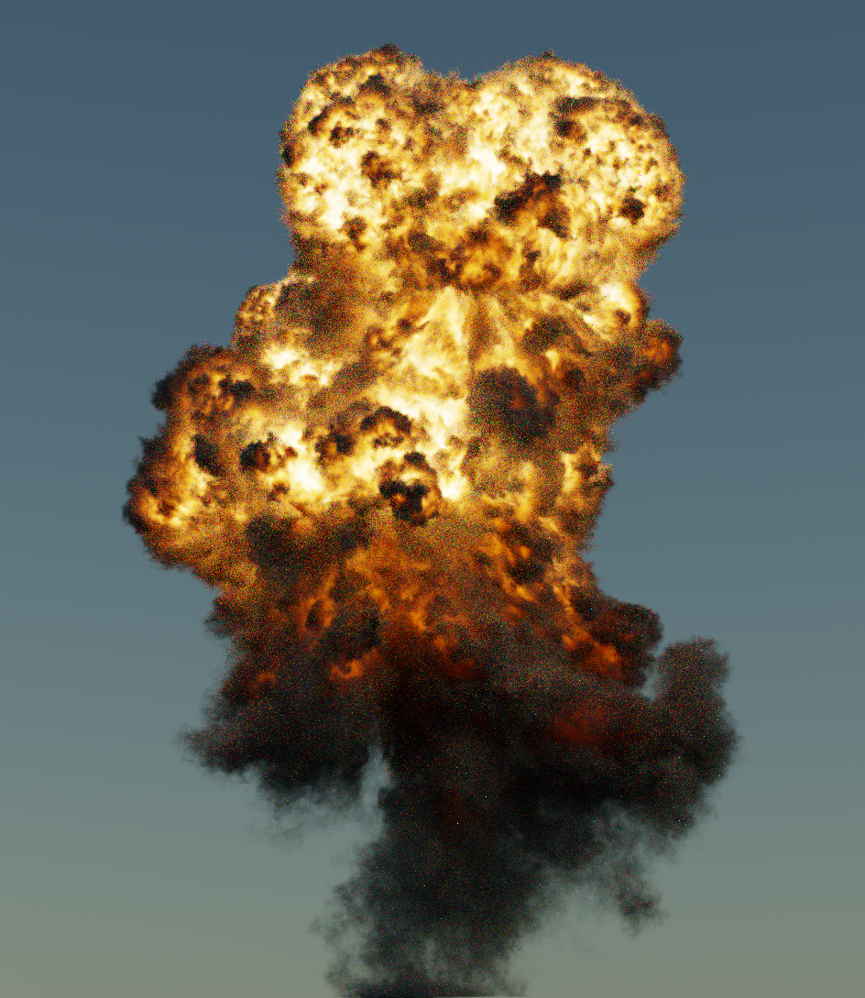
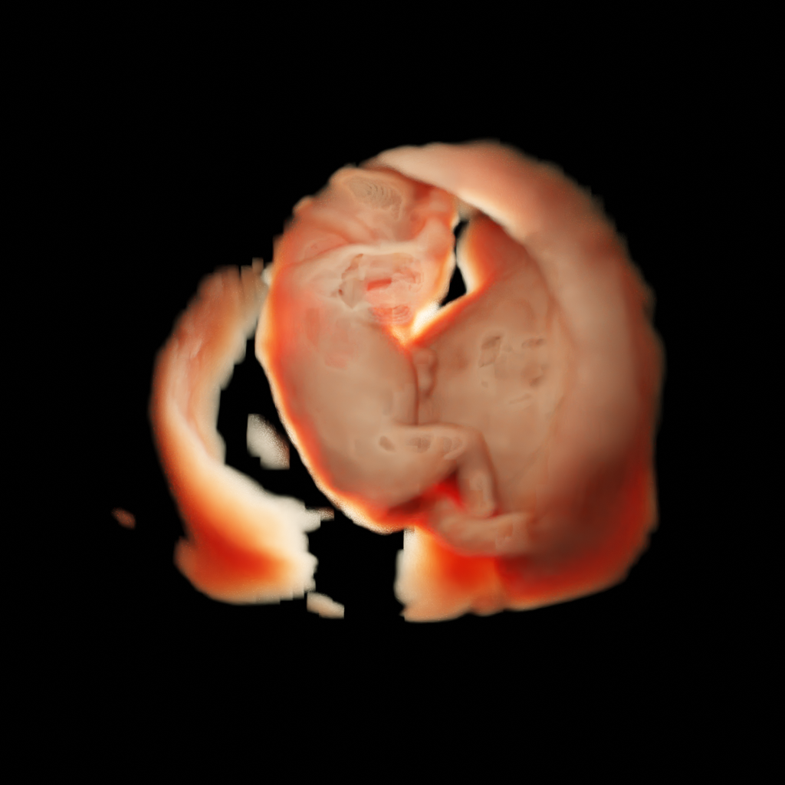


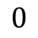

Volume Scattering (Simplified).
Volume Scattering Model
From PBRT-v4
Simplify it!
$$0$$
$$v$$
From PBRT-v4
Rendering via Blender

Slide 6

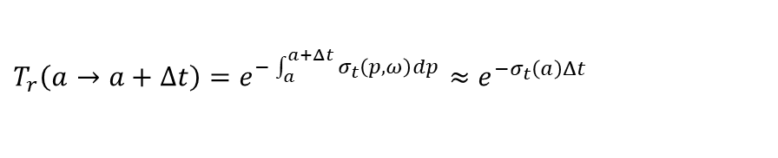



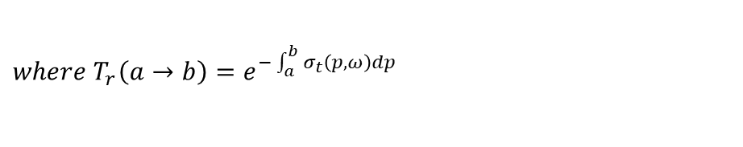







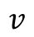

Volume Scattering (Simplified).
Volume Scattering Model
$$L\left(v,ω_{v}\right)=T_{r}\left(0→v\right)L_{0}+\int_{0}^{v}{T_{r}\left(p→v\right)σ_{t}\left(p,ω\right)L_{s}\left(p,−ω_{v}\right)dp}$$
$$where T_{r}\left(a→b\right)=e^{−\int_{a}^{b}{σ_{t}\left(p,ω\right)dp}}$$
$$T_{r}\left(a→a+Δt\right)=e^{−\int_{a}^{a+Δt}{σ_{t}\left(p,ω\right)dp}}≈e^{−σ_{t}\left(a\right)Δt}$$
$$0$$
$$v$$
$$L_{0}$$
$$L_{s}\left(p,ω\right)=\frac{σ_{a}}{σ_{t}}L_{e}+\frac{σ_{s}}{σ_{t}}\int_{Ω}{p\left(p,ω_{i},ω\right)L_{i}\left(p,ω_{i}\right)dω_{i}}$$
How to solve $L$ using sampling points ?
Simplify via Riemann Sum
$$ω_{v}$$
$$v$$
$$0$$
$$L\left(v,ω_{v}\right)=\sum_{i=0}^{N}{σ_{t}\left(p_{i}\right)L_{s}\left(p_{i},−ω_{o}\right) T_{r}\left(i\right)Δt}$$
$$, T_{r}\left(i\right)=\prod_{j=0}^{i}{e^{−σ_{t}\left(p_{j}\right)Δt}}$$
$$Δt$$
Notes:
Beer’s law

Slide 7
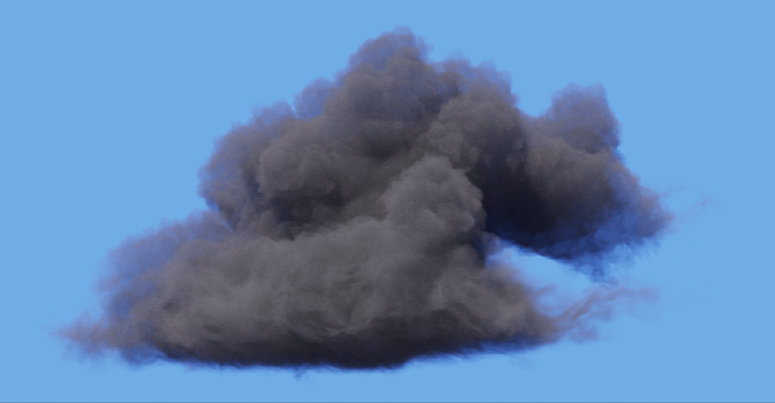
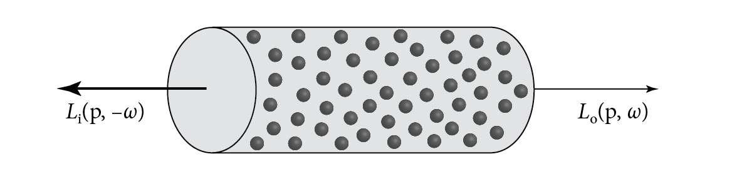
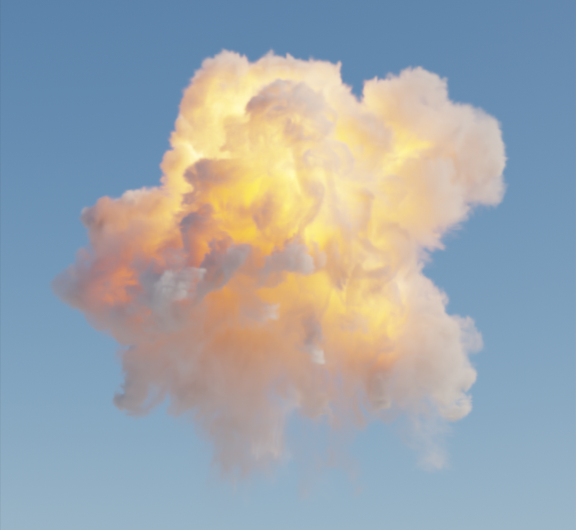
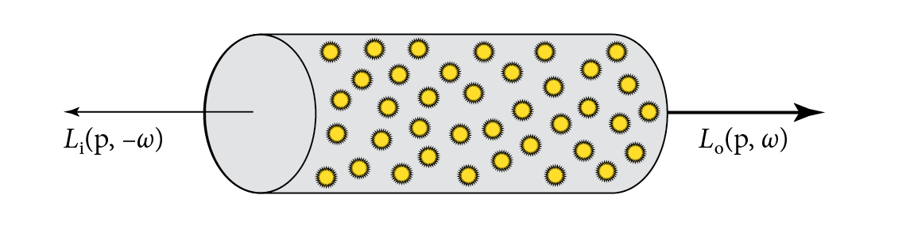
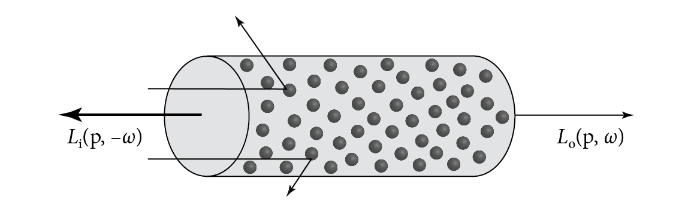
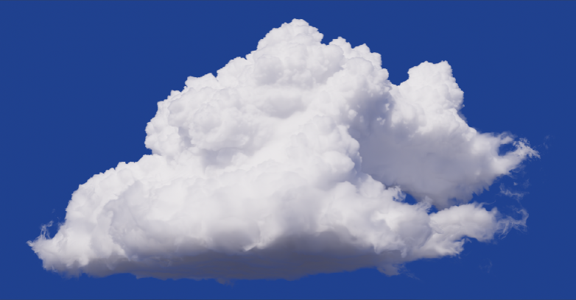
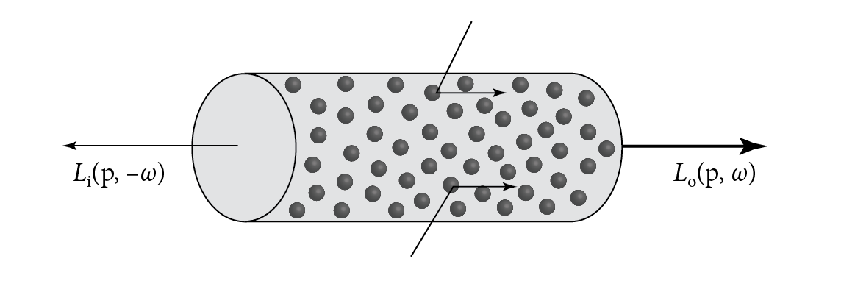





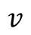
Radiance Field via Volume Rendering
How to Simplify $σ_{t}\left(p_{i}\right)L_{s}\left(p_{i},−ω_{o}\right)$
$$ω_{v}$$
$$v$$
$$0$$
$$σ_{t}\left(p_{i}\right)L_{s}\left(p_{i},−ω_{o}\right)$$
$$L\left(v,ω_{v}\right)=\sum_{i=0}^{N}{σ_{t}\left(p_{i}\right)L_{s}\left(p_{i},−ω_{o}\right) T_{r}\left(i\right)Δt}$$

Slide 8
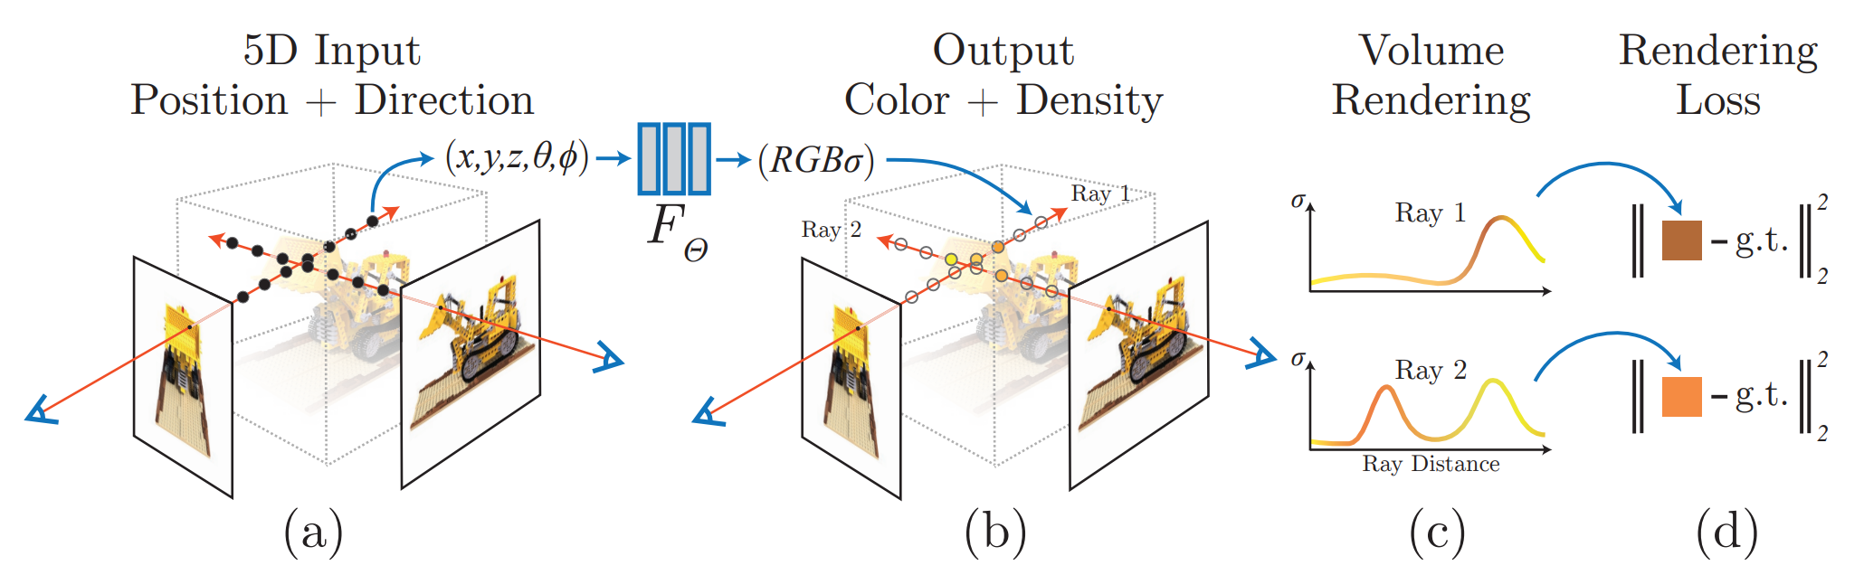
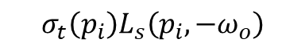



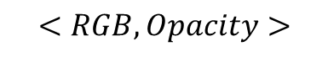
Radiance Field via Volume Rendering
NeRF: Neural Radiance Fields
$$ω_{v}$$
$$v$$
$$0$$
$$σ_{t}\left(p_{i}\right)L_{s}\left(p_{i},−ω_{o}\right)$$
$$σ_{t}\left(p_{i}\right)L_{s}\left(p_{i},−ω_{o}\right)$$
$$<RGB,Opacity>$$
$$<c_{i},σ_{i}>$$
$$L\left(v,ω_{v}\right)=\sum_{i=0}^{N}{σ_{t}\left(p_{i}\right)L_{s}\left(p_{i},−ω_{o}\right) T_{r}\left(i\right) Δt}$$
$$L\left(v,ω_{v}\right)=\sum_{i=0}^{N}{σ_{i} c_{i} T\left(i\right) Δt}, where T\left(i\right)=e^{−\sum_{j=0}^{i}{σ_{i}Δt}}$$
Mildenhall, Ben, et al. "Nerf: Representing scenes as neural radiance fields for view synthesis." Communications of the ACM 65.1 (2021): 99-106.

Slide 9
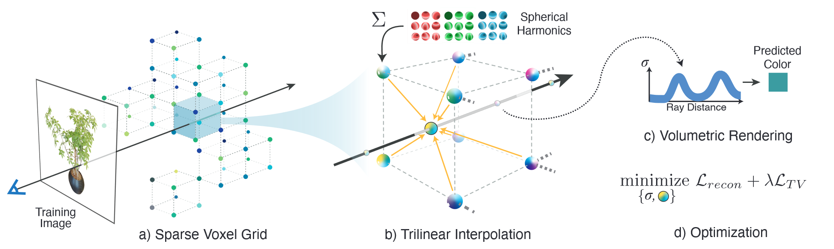

Radiance Field via Volume Rendering
Plenoxels: Radiance fields without neural networks
$$L\left(v,ω_{v}\right)=\sum_{i=0}^{N}{σ_{i} SH_{i}T\left(i\right) Δt}, where T\left(i\right)=e^{−\sum_{j=0}^{i}{σ_{i}Δt}}$$
Fridovich-Keil, Sara, et al. "Plenoxels: Radiance fields without neural networks." Proceedings of the IEEE/CVF Conference on Computer Vision and Pattern Recognition. 2022.

Slide 10
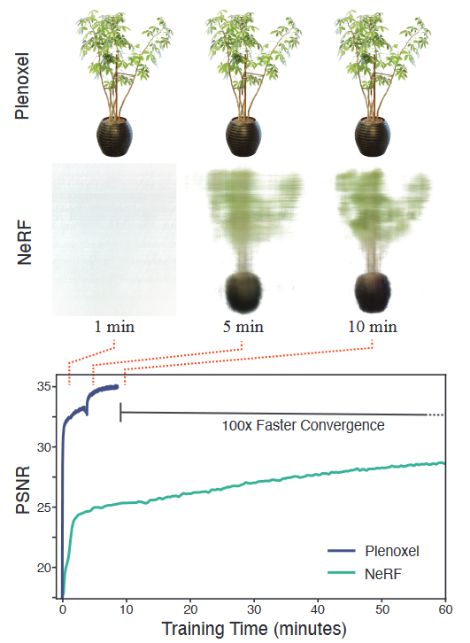
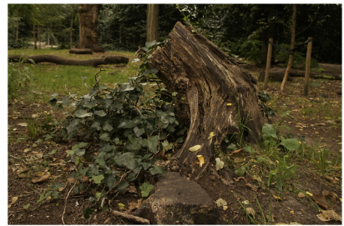
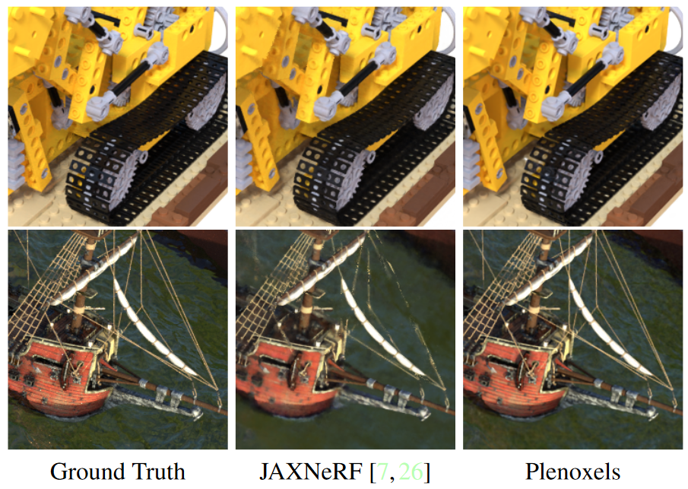
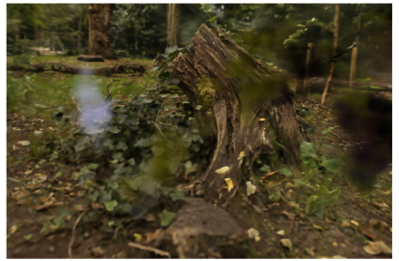
Radiance Field via Volume Rendering
Plenoxels: Radiance fields without neural networks
GT
Plenoxels
Fridovich-Keil, Sara, et al. "Plenoxels: Radiance fields without neural networks." Proceedings of the IEEE/CVF Conference on Computer Vision and Pattern Recognition. 2022.

Slide 11
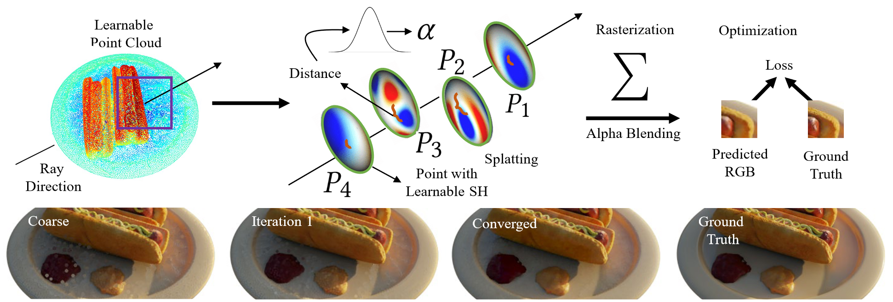


Radiance Field via Volume Rendering
Point-Based Radiance Fields via Differentiable Splat Rendering
$$L\left(v,ω_{v}\right)=\sum_{i=0}^{N}{α_{i}(p)SH_{i}T\left(i\right) Δt}, α_{i}(p)=\frac{1}{\sqrt{2πr^{2}}}e^{−\frac{{\left\|P_{i}−p\right\|}^{2}}{2r^{2}}}$$
Note. Based on 3-Sigma rule, we can use k-NN to find the k nearest Guass Kernel $P_{i}$.
Zhang, Qiang, et al. "Differentiable point-based radiance fields for efficient view synthesis." SIGGRAPH Asia 2022 Conference Papers. 2022.
Notes:
Princeton University, USA

Slide 12
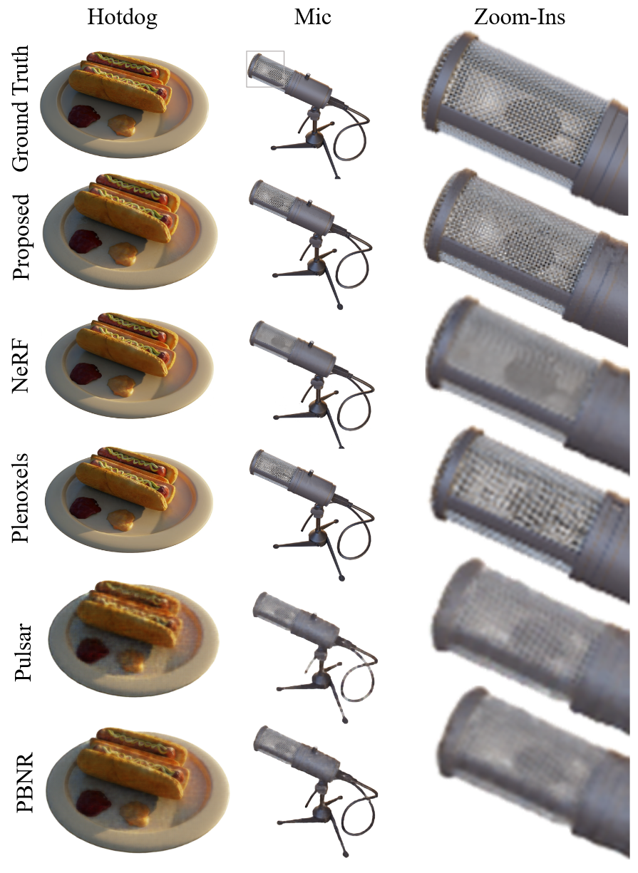
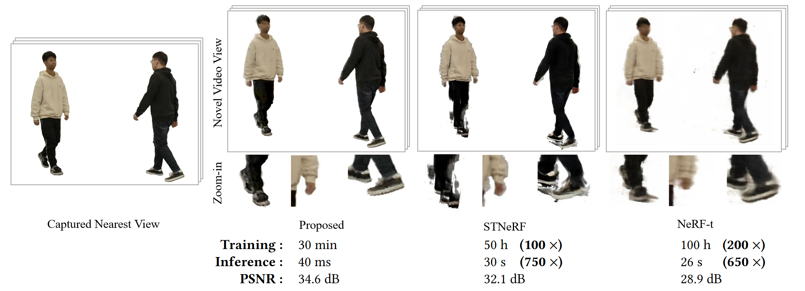
Radiance Field via Volume Rendering
Point-Based Radiance Fields via Differentiable Splat Rendering
Zhang, Qiang, et al. "Differentiable point-based radiance fields for efficient view synthesis." SIGGRAPH Asia 2022 Conference Papers. 2022.

Slide 13
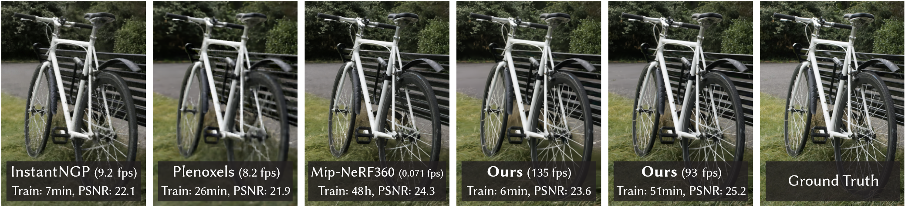
3D Gaussian Splatting for Real-Time Radiance Field Rendering
SIGGRAPH 2023 Best Paper
Bernhard Kerbl*, Georgios Kopanas*, Thomas Leimkühler, George Drettakis
¹Inria ²Université Côte d'Azur ³MPI Informatik
Kerbl, Bernhard, et al. "3d gaussian splatting for real-time radiance field rendering." ACM Transactions on Graphics (ToG) 42.4 (2023): 1-14.
Notes:
A6000

Slide 14
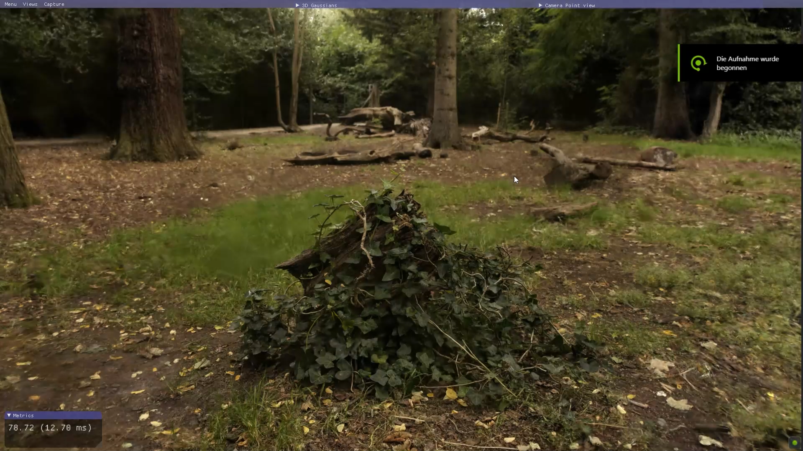
3D Gaussian Splatting
Kerbl, Bernhard, et al. "3d gaussian splatting for real-time radiance field rendering." ACM Transactions on Graphics (ToG) 42.4 (2023): 1-14.

Slide 15
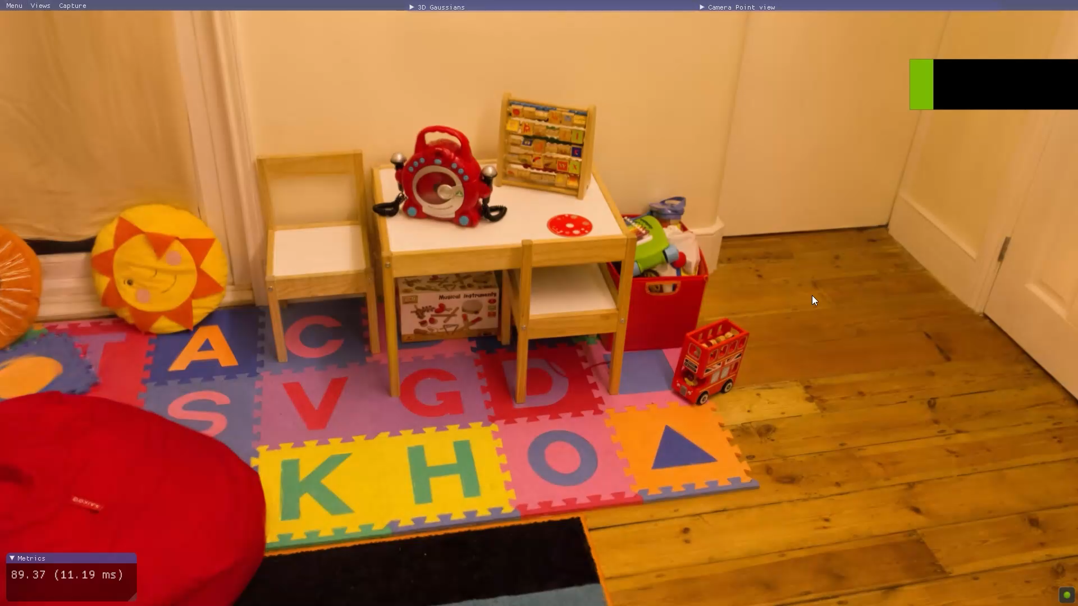
3D Gaussian Splatting
Kerbl, Bernhard, et al. "3d gaussian splatting for real-time radiance field rendering." ACM Transactions on Graphics (ToG) 42.4 (2023): 1-14.

Slide 16
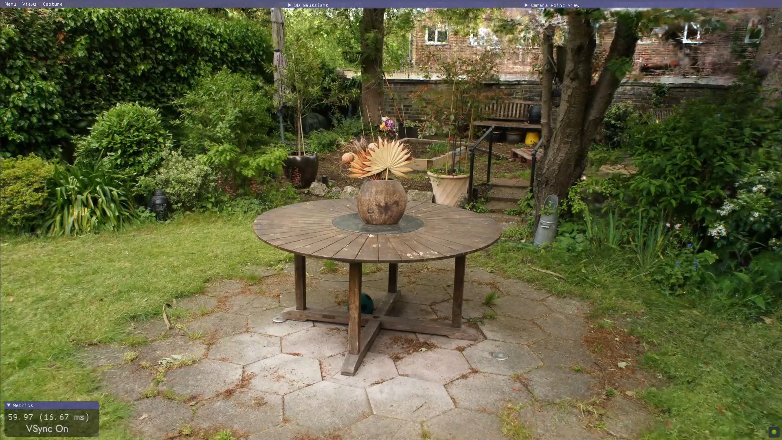
3D Gaussian Splatting
Kerbl, Bernhard, et al. "3d gaussian splatting for real-time radiance field rendering." ACM Transactions on Graphics (ToG) 42.4 (2023): 1-14.

Slide 17
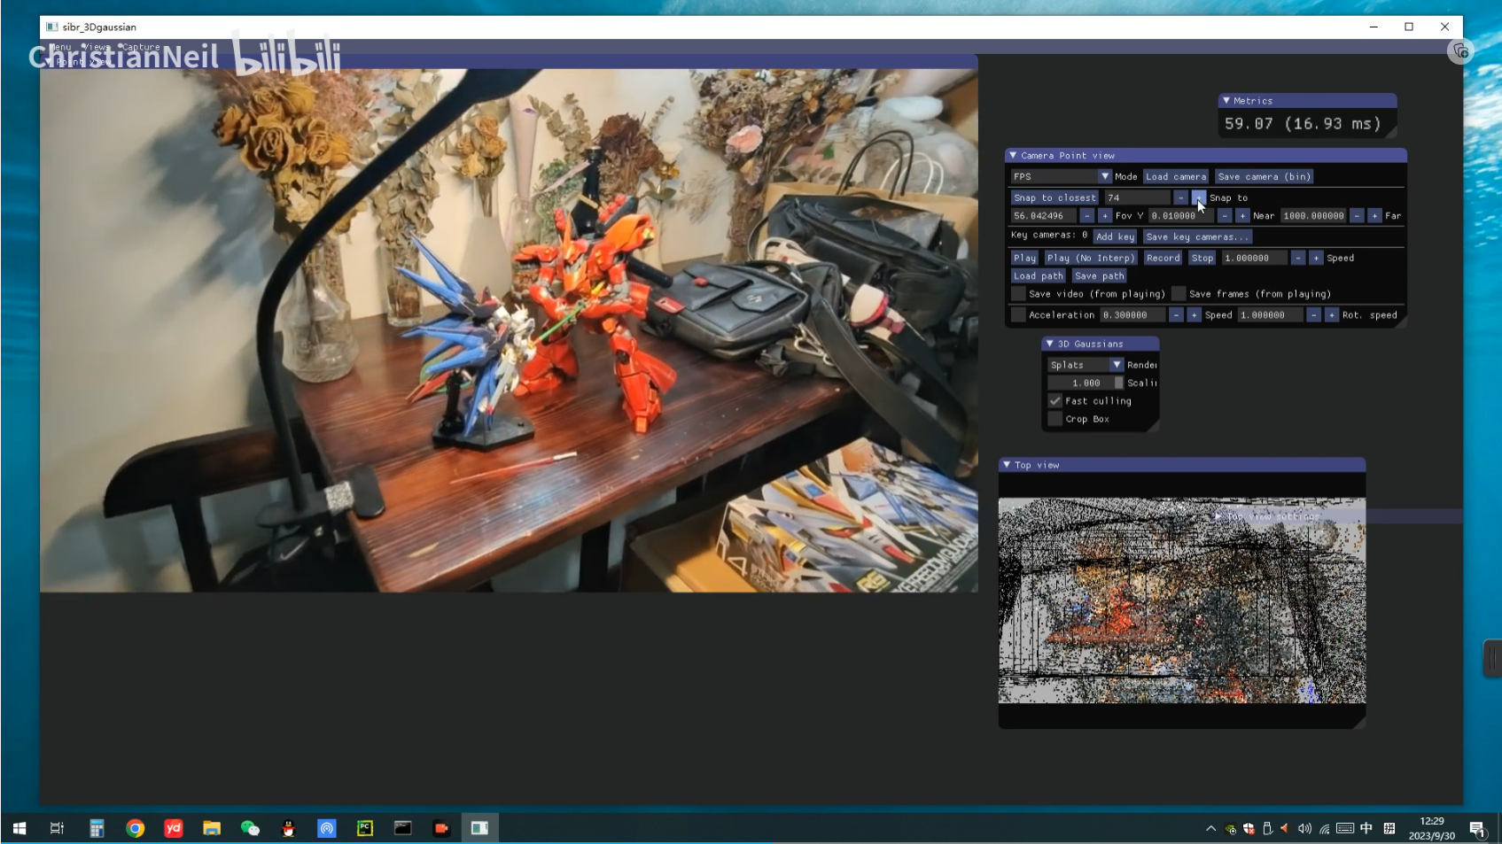
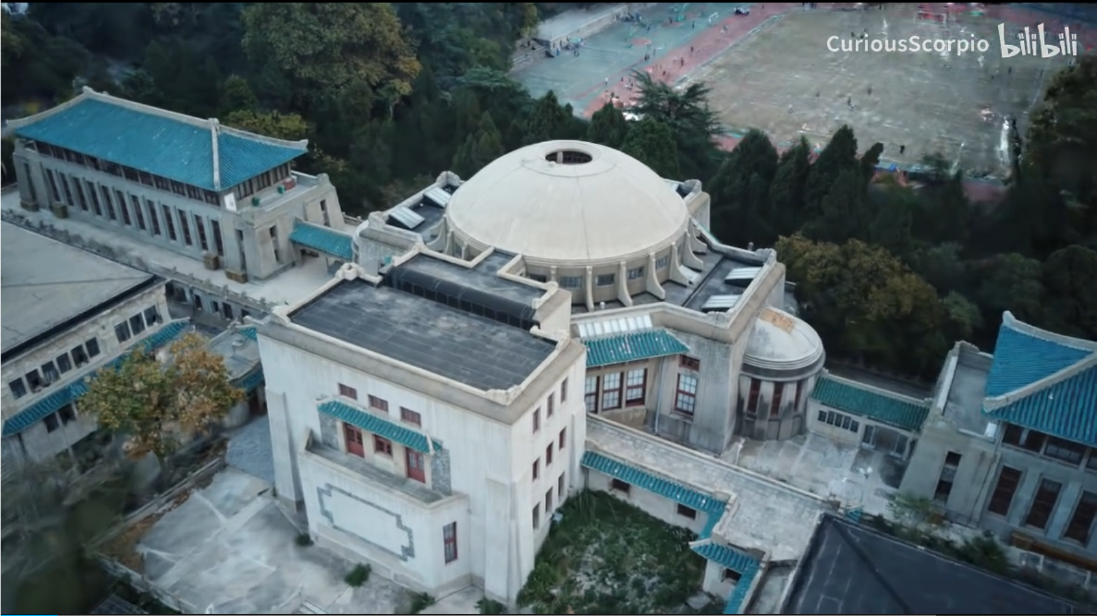
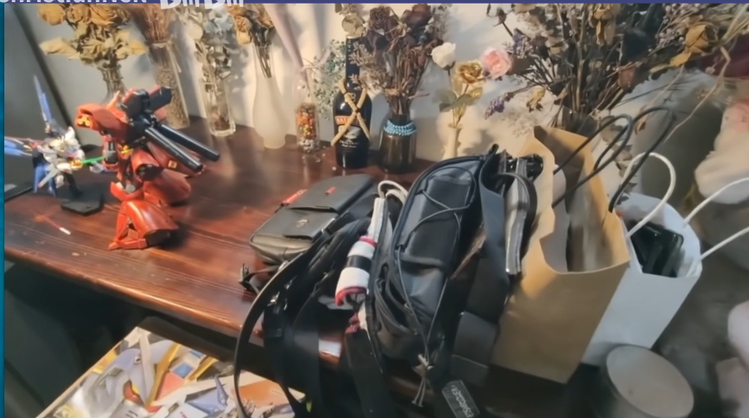
3D Gaussian Splatting
From Internet
Kerbl, Bernhard, et al. "3d gaussian splatting for real-time radiance field rendering." ACM Transactions on Graphics (ToG) 42.4 (2023): 1-14.

Slide 18





3D Gaussian Splatting
Pipeline
$$L\left(v,ω_{v}\right)=\sum_{i=0}^{N}{G_{i}(pos_{i}−p)α_{i}SH_{i}T\left(i\right) Δt}, G_{i}(x)=\frac{1}{w}e^{−\frac{1}{2}{\left(x\right)}^{T}Σ^{−1}\left(x\right)}$$
Camera Movement Sequence
Render Pipeline
Spare Gaussian
Point Cloud
Projection
Tile-Based
Renderer
$$𝓛$$
Image
$$<pos\left(mean\right),Σ,α,SH>$$
Note. 3DGS does not cite this Gauss Point-based work from 2022 Sig Asia at all.
Kerbl, Bernhard, et al. "3d gaussian splatting for real-time radiance field rendering." ACM Transactions on Graphics (ToG) 42.4 (2023): 1-14.

Slide 19



3D Gaussian Splatting
An efficient scheme
for initializing Gaussian positions and Camera
Anisotropic
3D Gaussians
Adaptive
Density Control
Fast Tile-Based Differentiable Rendering
How to project a Gaussian Ball as a tile on screen?
How to split Gaussians
to fill sparse regions?
Optimization
How to optimize the variables on Gaussians?
$$<pos\left(mean\right),Σ,α,SH>$$
Note. 3DGS does not cite this Gauss Point-based work from 2022 Sig Asia at all.
Kerbl, Bernhard, et al. "3d gaussian splatting for real-time radiance field rendering." ACM Transactions on Graphics (ToG) 42.4 (2023): 1-14.

Slide 20


3D Gaussian Splatting
Why use Anisotropic Gaussian
Kerbl, Bernhard, et al. "3d gaussian splatting for real-time radiance field rendering." ACM Transactions on Graphics (ToG) 42.4 (2023): 1-14.

Slide 21


3D Gaussian Splatting
SfM: Structure from Motion
An efficient scheme
for initializing Gaussian positions and Camera
Vedio
SfM
Image Sequence
Spare
Point Cloud
Camera Movement Sequence
Kerbl, Bernhard, et al. "3d gaussian splatting for real-time radiance field rendering." ACM Transactions on Graphics (ToG) 42.4 (2023): 1-14.

Slide 22

3D Gaussian Splatting
About Projection and How to optimize $Σ$
Anisotropic
3D Gaussians
How to project a Gaussian Ball as a tile on screen?
For adaptive camera Movement
Camera Movement Sequence
Kerbl, Bernhard, et al. "3d gaussian splatting for real-time radiance field rendering." ACM Transactions on Graphics (ToG) 42.4 (2023): 1-14.

Slide 23










3D Gaussian Splatting
About Projection and How to optimize $Σ$
Camera Matrix
Camera Movement Sequence
$$W :View Transform$$
Spare
Point Cloud
$$J :Projection$$
Anisotropic
3D Gaussians
How to project a Gaussian Ball as a tile on screen?
$$Σ^{′}=JW Σ W^{T}J^{T}$$
$$pos \left(mean\right)$$
z
$$Σ∈R^{3×3}$$
$$Σ′∈R^{2×2}$$
Optimization
$$Σ←Identity$$
How to optimize the variables on Gaussians?
$$<pos\left(mean\right),Σ,α,SH>$$
$$G\left(x\right)=e^{−\frac{1}{2}{\left(x\right)}^{T}Σ^{−1}\left(x\right)}$$
screen
Kerbl, Bernhard, et al. "3d gaussian splatting for real-time radiance field rendering." ACM Transactions on Graphics (ToG) 42.4 (2023): 1-14.

Slide 24




3D Gaussian Splatting
About Projection and How to optimize $Σ$
Anisotropic
3D Gaussians
1
How to project a Gaussian Ball as a tile on screen?
$$Σ∈R^{3×3}$$
$$Σ′∈R^{2×2}$$
Optimization
How to optimize the variables on Gaussians?
$$<pos\left(mean\right),Σ,α,SH>$$
screen
Kerbl, Bernhard, et al. "3d gaussian splatting for real-time radiance field rendering." ACM Transactions on Graphics (ToG) 42.4 (2023): 1-14.

Slide 25







3D Gaussian Splatting
About Projection and How to optimize $Σ$
$$Σ=RSS^{T}R^{T}$$
1
$$S: Scaling Matrix$$
Anisotropic
3D Gaussians
$$R: Rotation Matrix$$
How to project a Gaussian Ball as a tile on screen?
2
$$S←scaling vector s$$
Optimization
screen
$$R←unit quaternion q$$
How to optimize the variables on Gaussians?
$$<pos\left(mean\right),Σ,α,SH>$$
$$<pos\left(mean\right),Σ,α,SH>$$
3
$$<pos\left(mean\right),s,q,α,SH>$$
Kerbl, Bernhard, et al. "3d gaussian splatting for real-time radiance field rendering." ACM Transactions on Graphics (ToG) 42.4 (2023): 1-14.

Slide 26

















3D Gaussian Splatting
Optimization
Camera Movement Sequence
Render Pipeline
Spare Gaussian
Point Cloud
Projection
Tile-Based
Renderer
$$𝓛$$
Image
Optimization
How to optimize the variables on Gaussians?
$$<pos\left(mean\right),Σ,α,SH>$$
$$<pos\left(mean\right),s,q,α,SH>$$
$$ℒ=\left(1−λ\right)ℒ_{1}+λℒ_{D−SSIM}, where λ=0.2$$
Adaptive
Density Control
$$α′$$
$$α′$$
$$Σ′←ExpActFunc(Σ)$$
How to split Gaussians
to fill sparse regions?
$$1$$
$$1$$
$$SH←Init band=0$$
$$Sigmoid$$
$$Every 1000 iters:$$
$$SH←add one band$$
$$α$$
$$α$$
$$until band=4$$
$$1$$
Kerbl, Bernhard, et al. "3d gaussian splatting for real-time radiance field rendering." ACM Transactions on Graphics (ToG) 42.4 (2023): 1-14.

Slide 27



3D Gaussian Splatting
Adaptive Density Control
Camera Movement Sequence
Render Pipeline
Spare Gaussian
Point Cloud
Projection
Tile-Based
Renderer
$$𝓛$$
Image
Optimization
How to optimize the variables on Gaussians?
$$<pos\left(mean\right),Σ,α,SH>$$
$$<pos\left(mean\right),s,q,α,SH>$$
Every 100 Iterations
$Gaussian [pos] grid g_{i}$
Adaptive
Density Control
How to split Gaussians
to fill sparse regions?
$$if \left\|g_{i}\right\|>τ_{pos}$$
$$if \left\|Σ\right\|<threshold$$
Kerbl, Bernhard, et al. "3d gaussian splatting for real-time radiance field rendering." ACM Transactions on Graphics (ToG) 42.4 (2023): 1-14.

Slide 28



3D Gaussian Splatting
Adaptive Density Control
Camera Movement Sequence
Render Pipeline
Spare Gaussian
Point Cloud
Projection
Tile-Based
Renderer
$$𝓛$$
Image
Optimization
How to optimize the variables on Gaussians?
$$<pos\left(mean\right),Σ,α,SH>$$
$$<pos\left(mean\right),s,q,α,SH>$$
Every 100 Iterations
Adaptive
Density Control
$$opacity α_{i}$$
$$if α_{i}<ε_{α}$$
$$remove Gaussian P_{i}$$
How to split Gaussians
to fill sparse regions?
In order to remove Outliers.
Kerbl, Bernhard, et al. "3d gaussian splatting for real-time radiance field rendering." ACM Transactions on Graphics (ToG) 42.4 (2023): 1-14.

Slide 29

3D Gaussian Splatting
Rendering
Fast Tile-Based Differentiable Rendering
Kerbl, Bernhard, et al. "3d gaussian splatting for real-time radiance field rendering." ACM Transactions on Graphics (ToG) 42.4 (2023): 1-14.

Slide 30




3D Gaussian Splatting
Baseline
(Nvidia) InstantNGP
(Google) Mip-NeRF 360
(Berkeley) Plenoxels
Barron, Jonathan T., et al. "Mip-nerf 360: Unbounded anti-aliased neural radiance fields." Proceedings of the IEEE/CVF Conference on Computer Vision and Pattern Recognition. 2022.
Müller, Thomas, et al. "Instant neural graphics primitives with a multiresolution hash encoding." ACM Transactions on Graphics (ToG) 41.4 (2022): 1-15.
Fridovich-Keil, Sara, et al. "Plenoxels: Radiance fields without neural networks." Proceedings of the IEEE/CVF Conference on Computer Vision and Pattern Recognition. 2022.

Slide 31



3D Gaussian Splatting

Slide 32


3D Gaussian Splatting

Slide 33



3D Gaussian Splatting
$$N=10$$

Slide 34

3D Gaussian Splatting

Slide 35

3D Gaussian Splatting

Slide 36
3D Gaussian Splatting

Slide 37

3D Gaussian Splatting

Slide 38


3D Gaussian Splatting

Slide 39
3D Gaussian Splatting
For training large scenes, peak GPU memory consumption can exceed 20GB.
Test: less than 4GB

